Slide 1
WILDFIRE PREDICTION & PREVENTION
-DEFENDERS

Slide 2
WILDFIRES ??
A wildfire, wildland fire or rural fire is an uncontrolled fire in an area of combustible vegetation occurring in rural or forest areas.
“Only you can prevent forest fires.”

Slide 3
MAJOR CAUSES
DRY CLIMATE
LIGHTNING
VOLCANIC ERUPTION
Weather patterns such as temperature, humidity & soil moisture ridges can increase the risk and alter the behavior of wildfires dramatically.

Slide 4
Environmental impacts
PROBLEMS:
Huge destruction of flora and fauna.
Huge impact on climate change.
Exposing hazardous materials to the air.
Global Warming drastically

Slide 5
TECH USED
IOT
To collect and transfer real time weather data wirelessly to concerned auth.
ML
To predict the possibility and probability of wildfire before fire burst out through climatic fctors

Slide 6
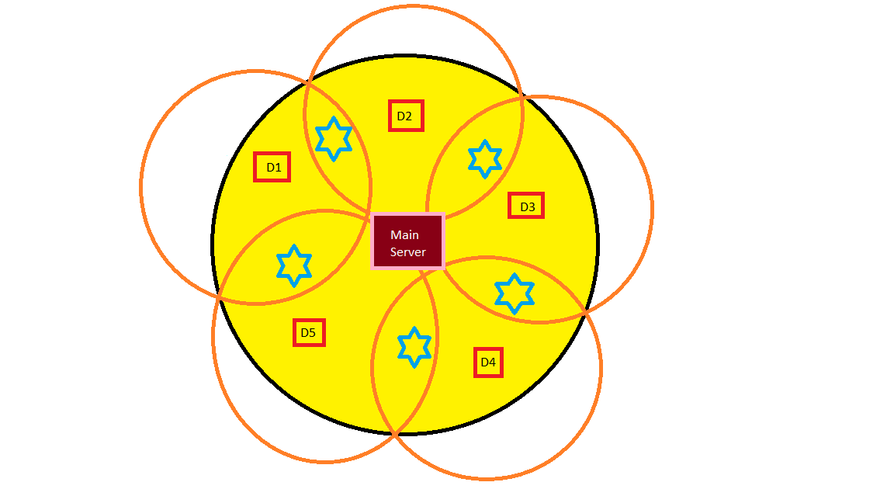
System architecture

Slide 7
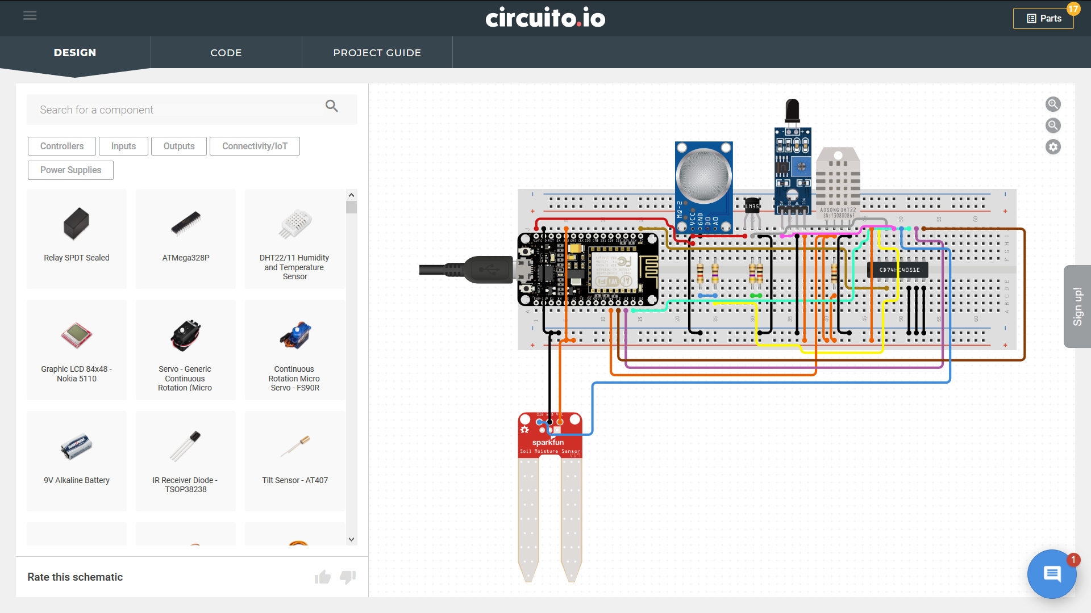
System Architecture CONT…

Slide 8
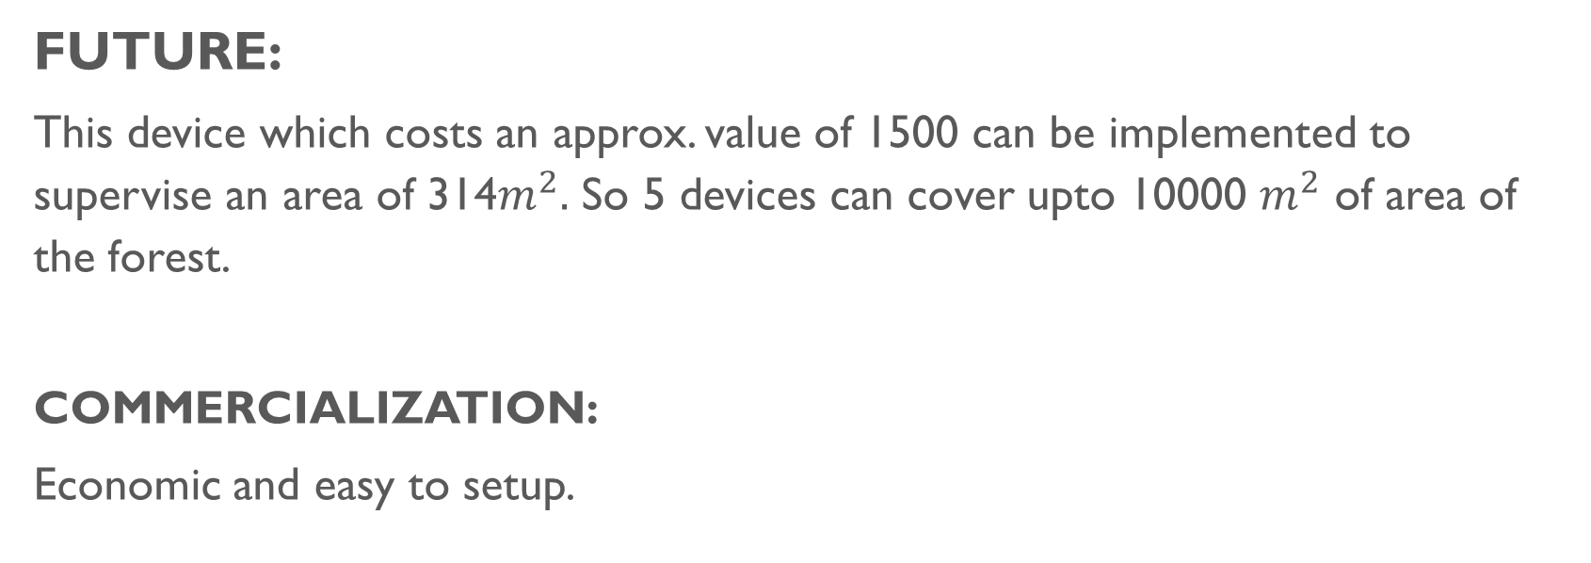
Future
FUTURE:
This device which costs an approx. value of 1500 can be implemented to supervise an area of 314$m^{2}.$ So 5 devices can cover upto 10000 $m^{2}$ of area of the forest.
COMMERCIALIZATION:
Economic and easy to setup.

Slide 9
THANK you … … … …
TEAM
MEMBERS
PRAKANSHU SAHU
PRANJUL ITONDIA
PRIYA SHARMA
SHIVAM BISHT

